Slide 1
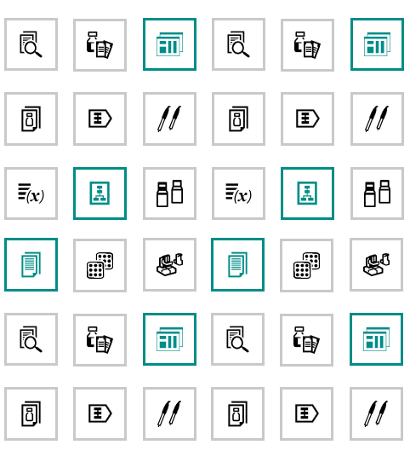

Overview & Basic Operation
OMNIS 4.0
Metrohm USA

Slide 2
Content
Work Areas
Samples area
  Running an analysis (video guide)
Process area
Equipment area
Settings
OMNIS: system overview/hierarchy
OMNIS: Workflow
Variables
Reserving an Instrument
Manual Control
Properties and Firmware
Creating a work system
  Creating a work system (video guide)
Creating Methods
Creating Operating Procedures (OPs)
Subsample variables in the OP
Calculations
Calculations, Formula Editor
Importing Template OPs (and methods)
Saving a titer value
Calibrating a pH electrode
Creating a sample profile
Sample lists
Sample list icons
Starting a sample list
Running a sample
Curves and data
Results
Subsample
Creating Reports
Backup Database
Database administration
OMNIS Support

Slide 3
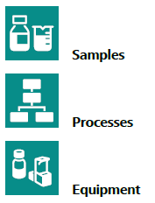
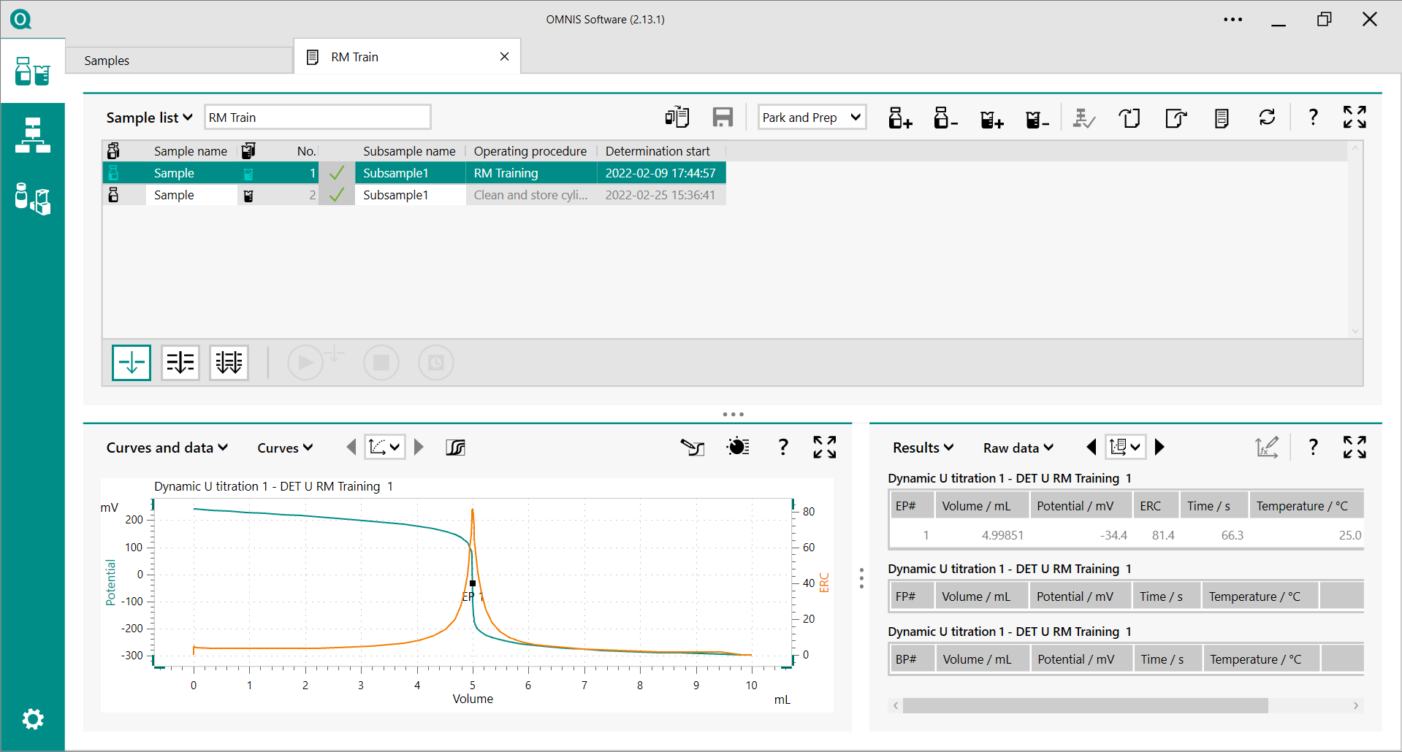

Work Areas

Slide 4
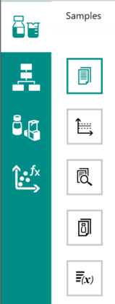
Subsections - Samples
Sample Lists – Create a sample table and run samples, view a live titration or historical curve/result and reprocess data
Control Charts - Control charts can be created, edited, and displayed
Search Queries – search for samples analyzed
Sample Profiles – template for creating samples, (OP linked to sample, number of sub-samples, ect)
Sample Variables – variable defined in samples that can be used in methods or OPs
Sample Lists
Control Charts
Search Queries
Sample Profiles
Sample Variables

Slide 5
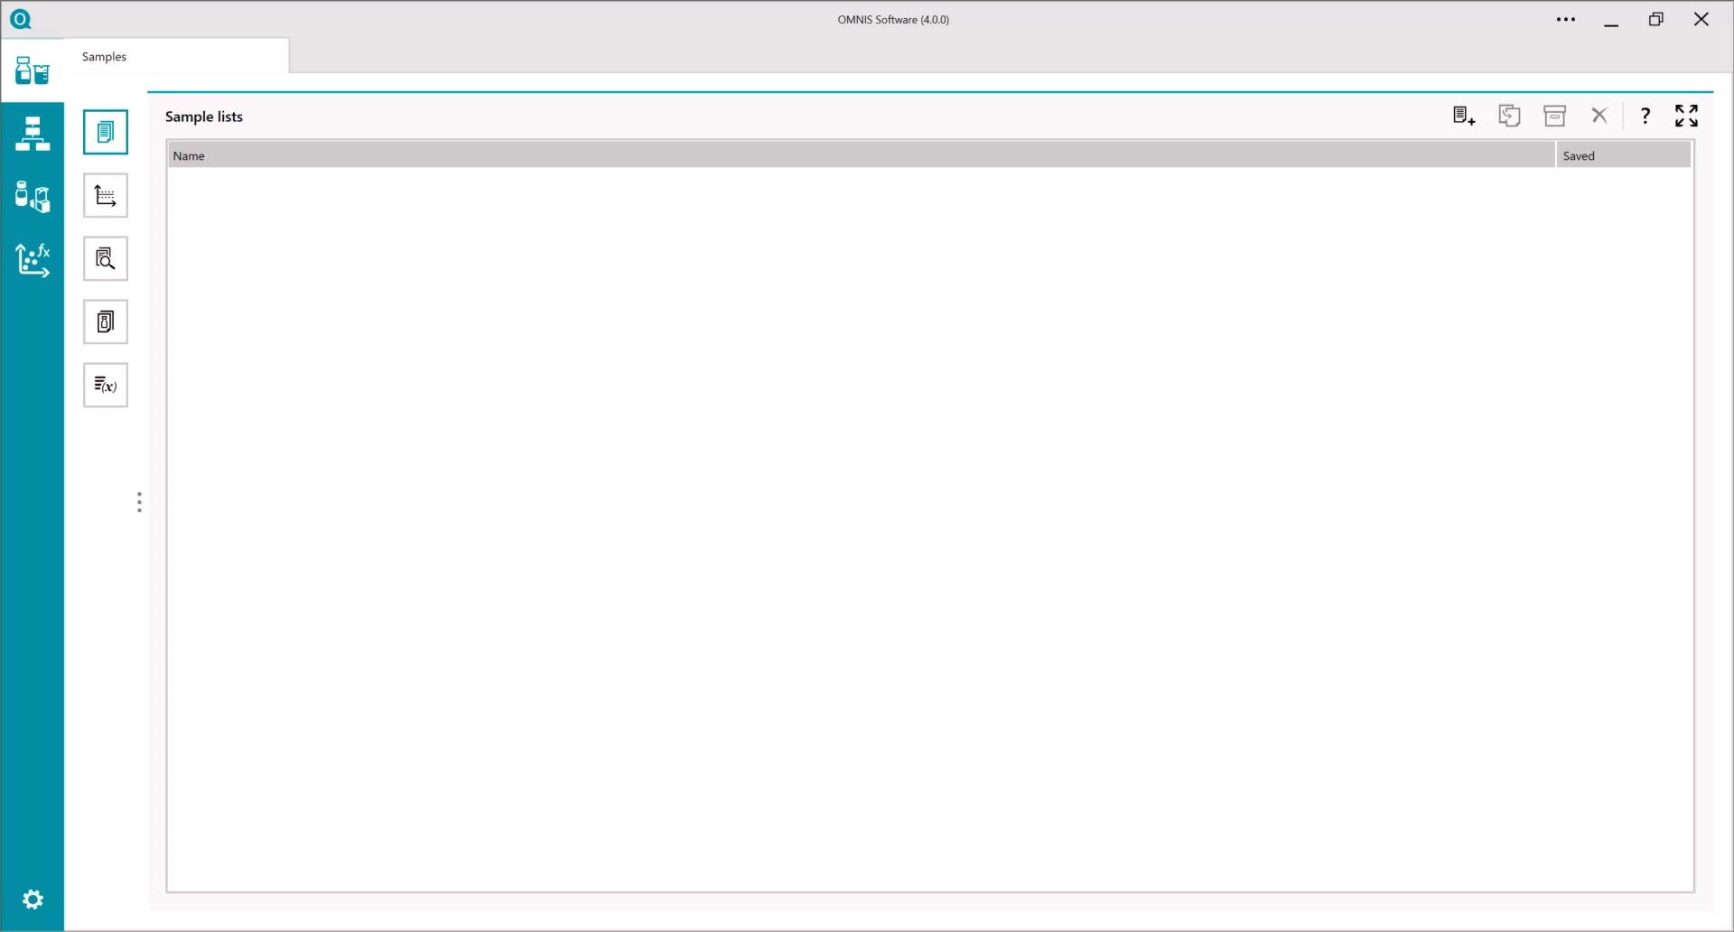
Running your first analysis- a video guide
(no audio)

Slide 6
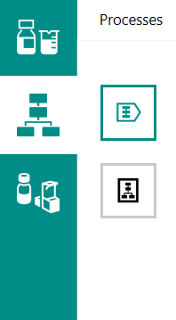
Subsections - Processes
Operating Procedure
Methods
Operating Procedures (OP) – defines the work sequence for the analysis of samples. OPs are defined by methods and commands that can be run sequentially or in parallel
Methods – combination of commands arranged sequentially or in parallel. Methods must be assigned work systems and contained in an OP

Slide 7
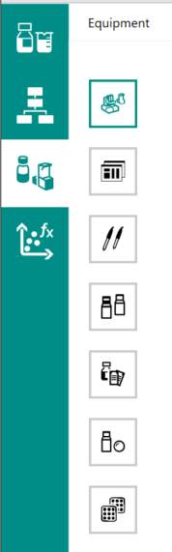
Subsections - Equipment
Instruments
Work System (WS)
Sensors
Solutions
Custom Calibration Buffers
Standards
Sample Racks
Instruments – comprised of one or more functional units and used for performing analysis and connected via a network
Work Systems – functional units reserved by the user. At least one WS must be assigned to a method contained in an OP
Sensors – used for measuring a physical or chemical properties. Can be digital or analog.

Slide 8
Subsections - Equipment
Instruments
Work System (WS)
Sensors
Solutions
Custom Calibration Buffers
Standards
Sample Racks
Solutions – reagents (titrants & auxiliary) that are dosed with a dosing unit
Custom Calibration Buffers – If commercially available pH buffers are not used, custom calibrated buffer solutions can be entered into the table for calibration of a pH electrode
Standards - Standards are used for reference standardization. Ex: NIR reflection standards
Sample Racks – used for the storage of sample vessels and placed on the rack base of the sample robot

Slide 9
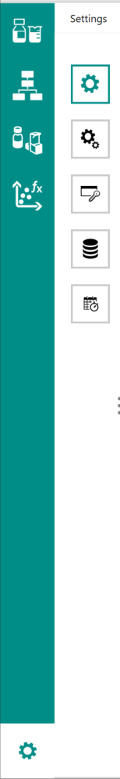

Subsections - Settings
General Settings
Advanced Setting
Software Licenses
Database Settings
Scheduler
General Settings – access user interface, emergency stop button, printer options, and notifications
Advanced Settings – access advanced settings, such as system (language), user management, and compliance
Software Licenses – add software licenses to increase functionality of titrator and number of instruments that can be connected
Data Management – backup database
Scheduler – Create a task which can be executed at a specific time, or an execution interval.

Slide 10
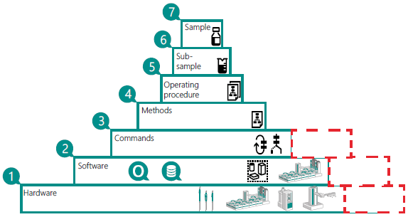
OMNIS Software System Overview
Hardware – OMNIS instruments are connected and populate instrument inventory
Software – Hardware and functional units are reserved in work systems
An assortment of commands are available to put in an order to create a method (4)
Methods are sequences of commands
Operating procedures are sequences of methods and commands
A sample profile links an operating procedure and number of sub-samples to run
Focus is on the sample which contains components of all the above-mentioned items

Slide 11
OMNIS Workflow
Work System
Create Work System
Check Work System
Operating Procedure
Create Operating Procedure
Create Method(s)
Method
Operating Procedure
Sample Profile
Sample List
Build operating procedure from methods and commands
Create New Sample Profile
Create new sample list
Assign work system to method
Before a sample can be run for the first time, a work system needs to be defined and used in a method. Methods are used in the operating procedure (OP) and OPs are used in a sample profile

Slide 12
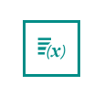
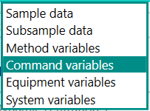
Variables
System Variables
Variables that are defined across the whole system including methods and OPs.
Defined in the samples work area
Blank values could be saved as system variables
Method Variables
Method specific variables
Not commonly used
Command Variables
Variables that are generated by individual commands in the process sequence
The endpoint of a titration command will be a command variable
Equipment Variables
Assigned work systems, sensors variables, rack variables and solution variables
The titer value written to the RFID chip of a bottlecap is one example
Variables can be stored and saved, categorized by their use
Variables can be used in the calculations of methods and operating procedures

Slide 13
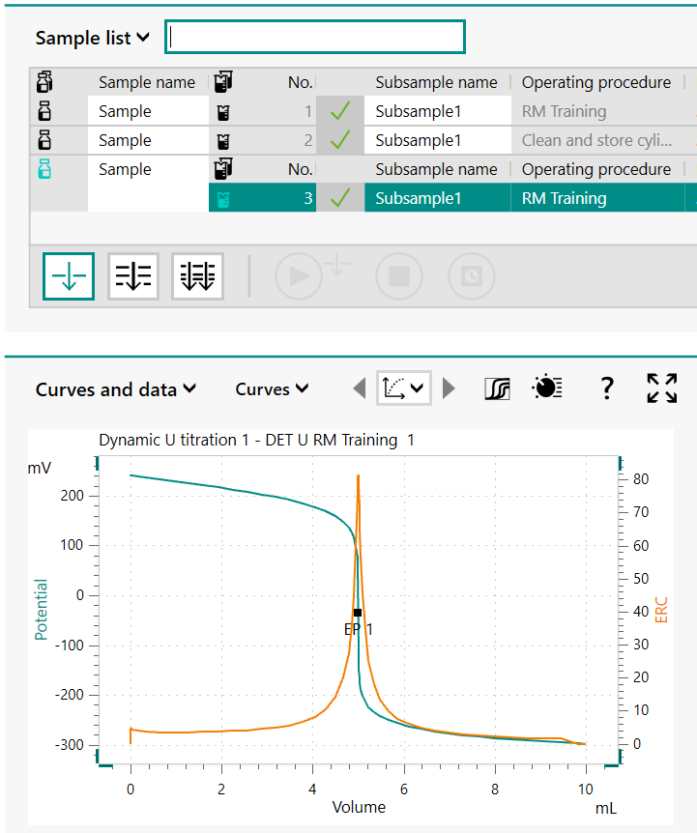
OMNIS Software Basics

Slide 14

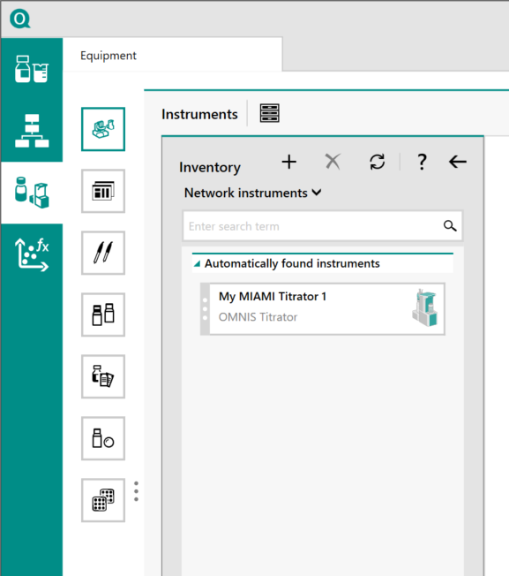
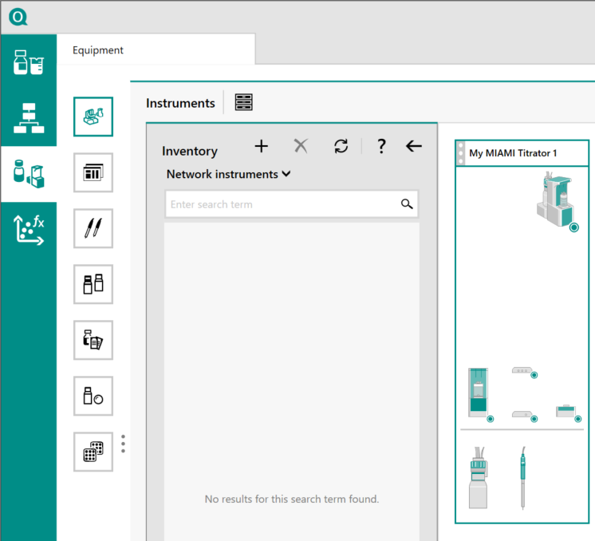
Reserving an Instrument
Networked instruments will be displayed in the instruments inventory
If an expected instrument is not displayed, check the network priorities
Click-and-drag instruments over to reserve the instrument. The instrument and all its functional units will be displayed, and the device will be removed from the inventory of networked instruments

Slide 15

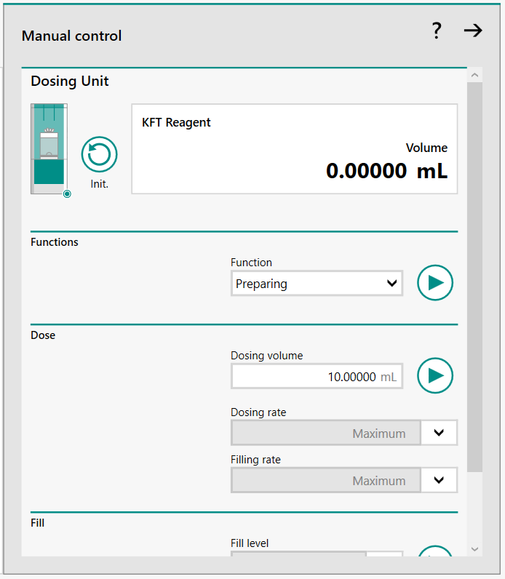
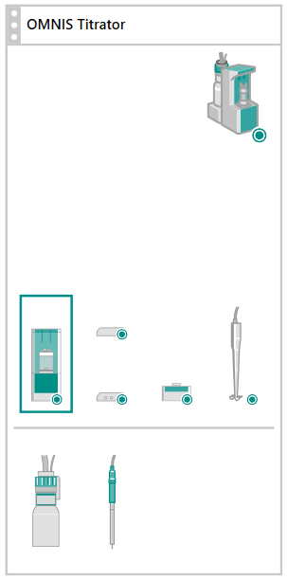
Manual Control
Double click on a functional unit or click on a functional unit and press the manual control icon
Initialize a device if it has lost communication. An orange circle next to an instrument or functional unit will indicate lost communication
Prepare, empty or put the cylinder in the exchange position
Dose a defined volume from the dosing port
Fill or aspirate a defined volume from the filling port

Slide 16

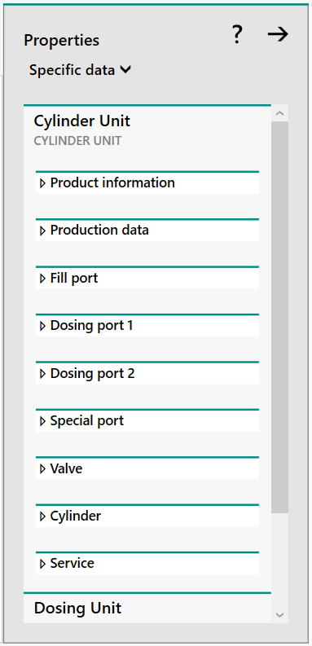
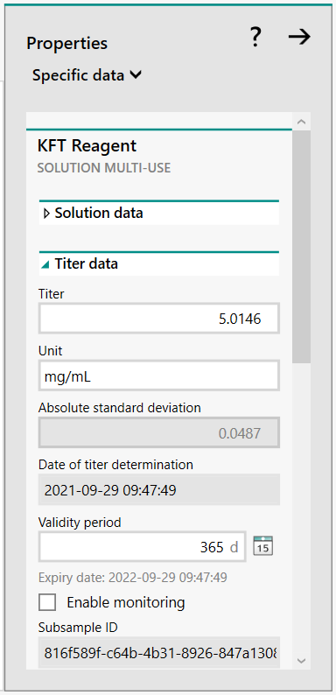
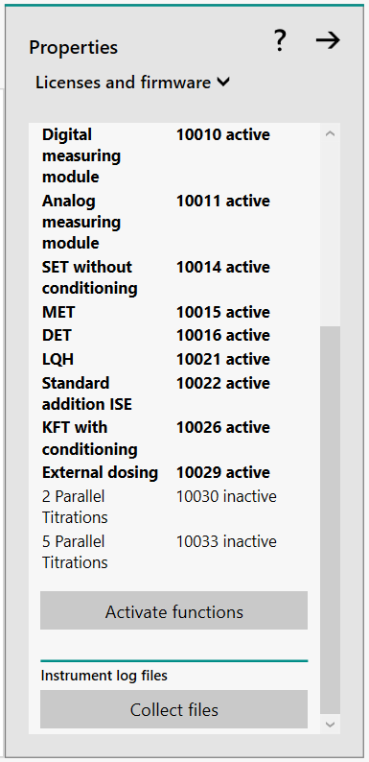
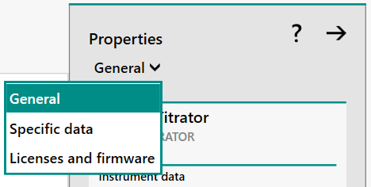
Properties & Firmware
Click on the Properties icon and select Specific data of dosing unit to define dosing and filling ports
Specific data of the solution to name the solution, see titer data
Licenses and firmware of the titrator to see what functions are active and to activate additional licenses

Slide 17

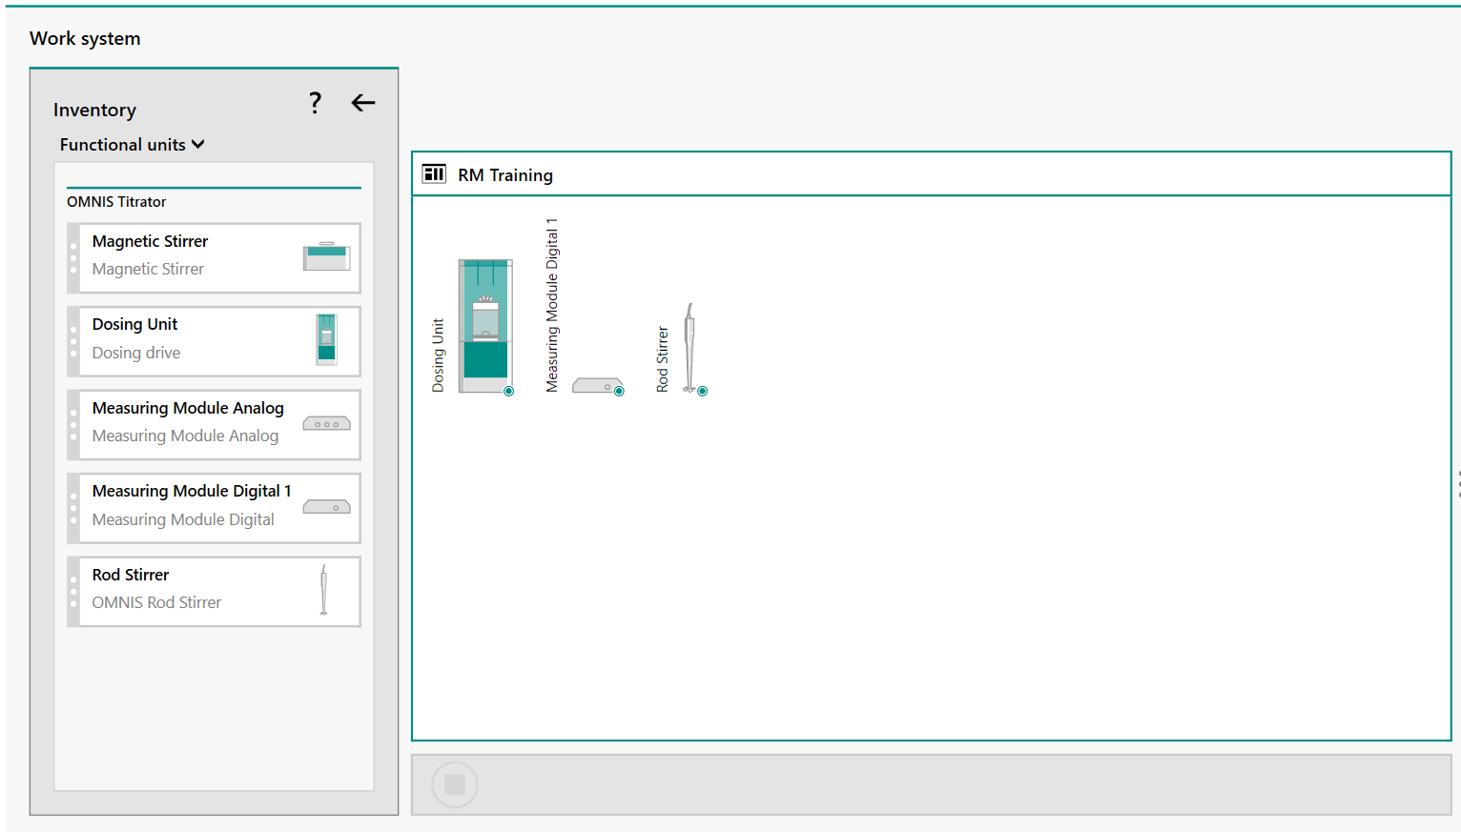
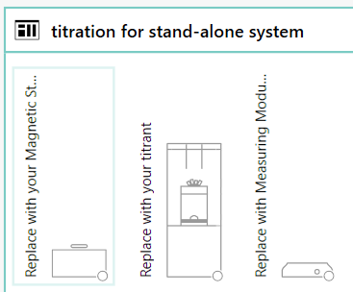
Creating Work Systems
A work system (WS) reserves functional units that will be used while running a processes (i.e. OP)
Drag-and-drop functional units to be used
If an OP is imported in, the WS will have silhouettes of functional units. Drag-and drop over the matching functional units, but do not delete any silhouette functional units

Slide 18
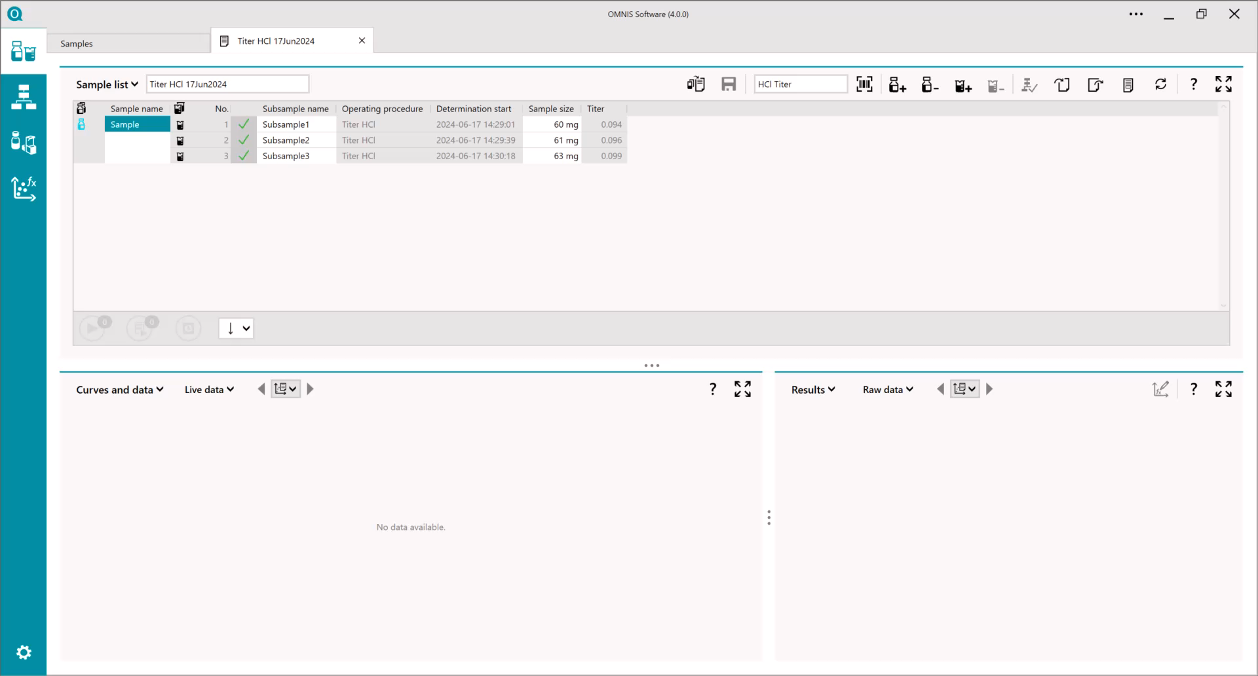
Creating a work system – a video guide
(no audio)

Slide 19

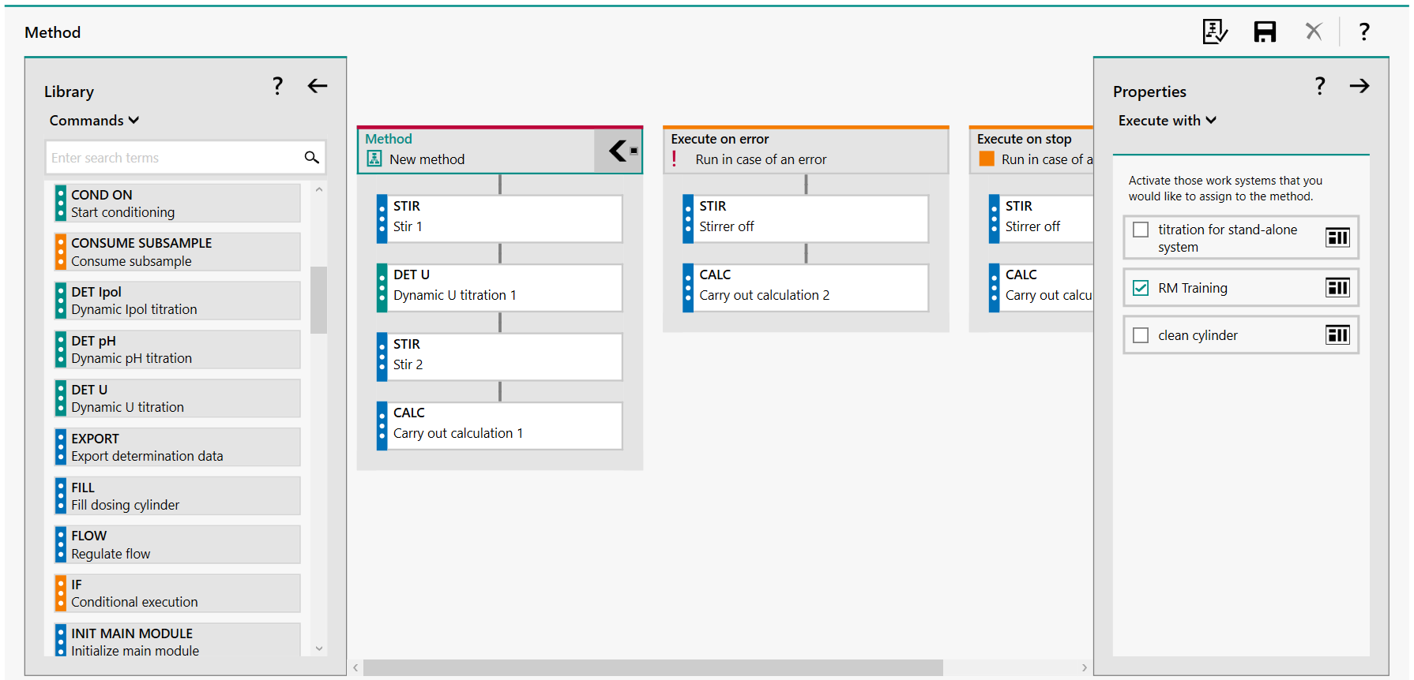
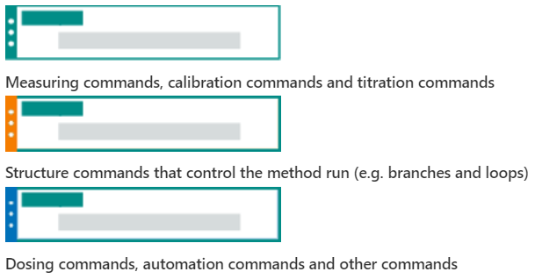
Creating Methods
Create a new method or import a method template
Drag-and-drop commands from the library into a sequential order
Click on an individual command to enter parameters
Under method properties, select a WS to execute with
Option runs can be added to the method to run in case of an error or stop

Slide 20

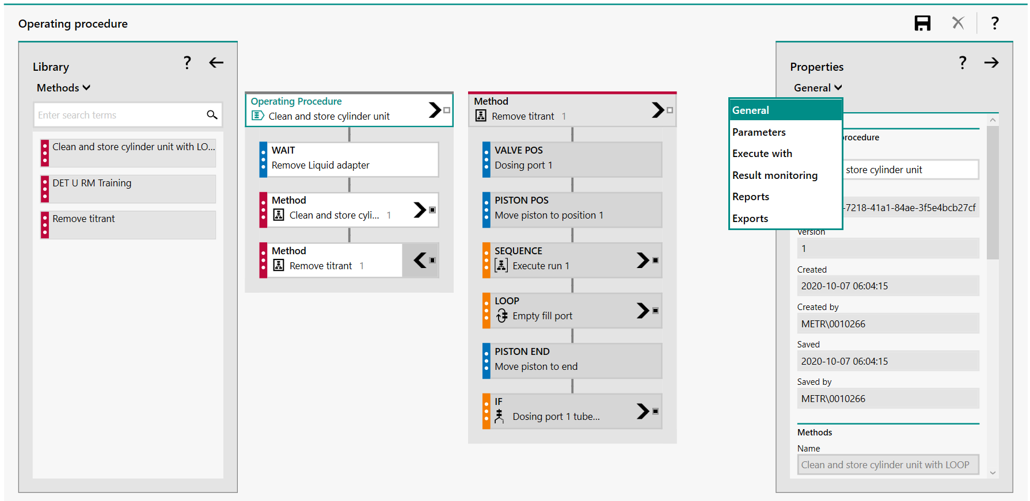

Creating Operating Procedures (OP)
An OP is a collection of methods and commands
Methods can be expanded to see the sequence and parameters, but cannot be edited
Commands are limited, no hardware or titration commands
The OP parameters defines subsample variables (i.e. rack position, sample positon, sample size, a result)
Magenta tabs are methods

Slide 21
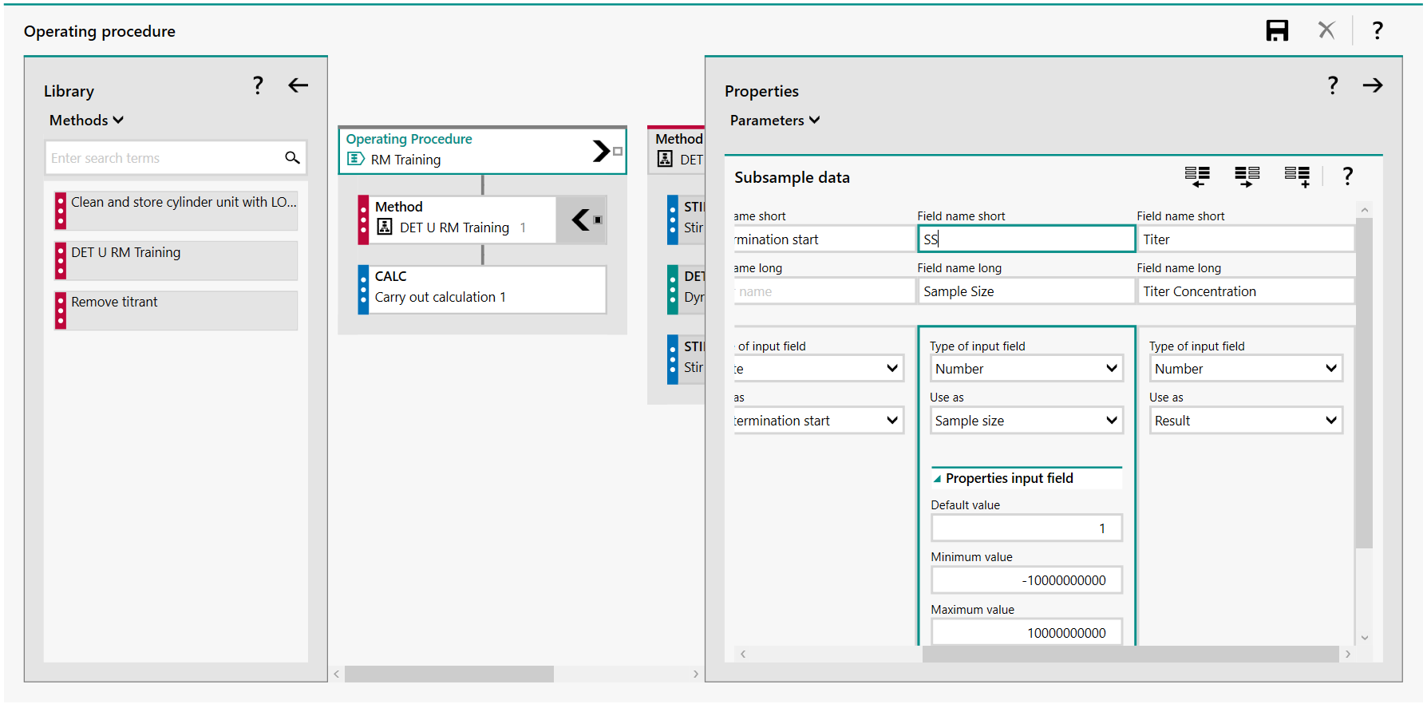
Subsample Variables in the OP
Subsample variables are defined in the OP and will be displayed in the sample list
Click on the OP heading, then properties > parameters and add column
Sample size, sample position and results are input fields that use a number
Remember to save the OP if you need to use one in a method formula

Slide 22
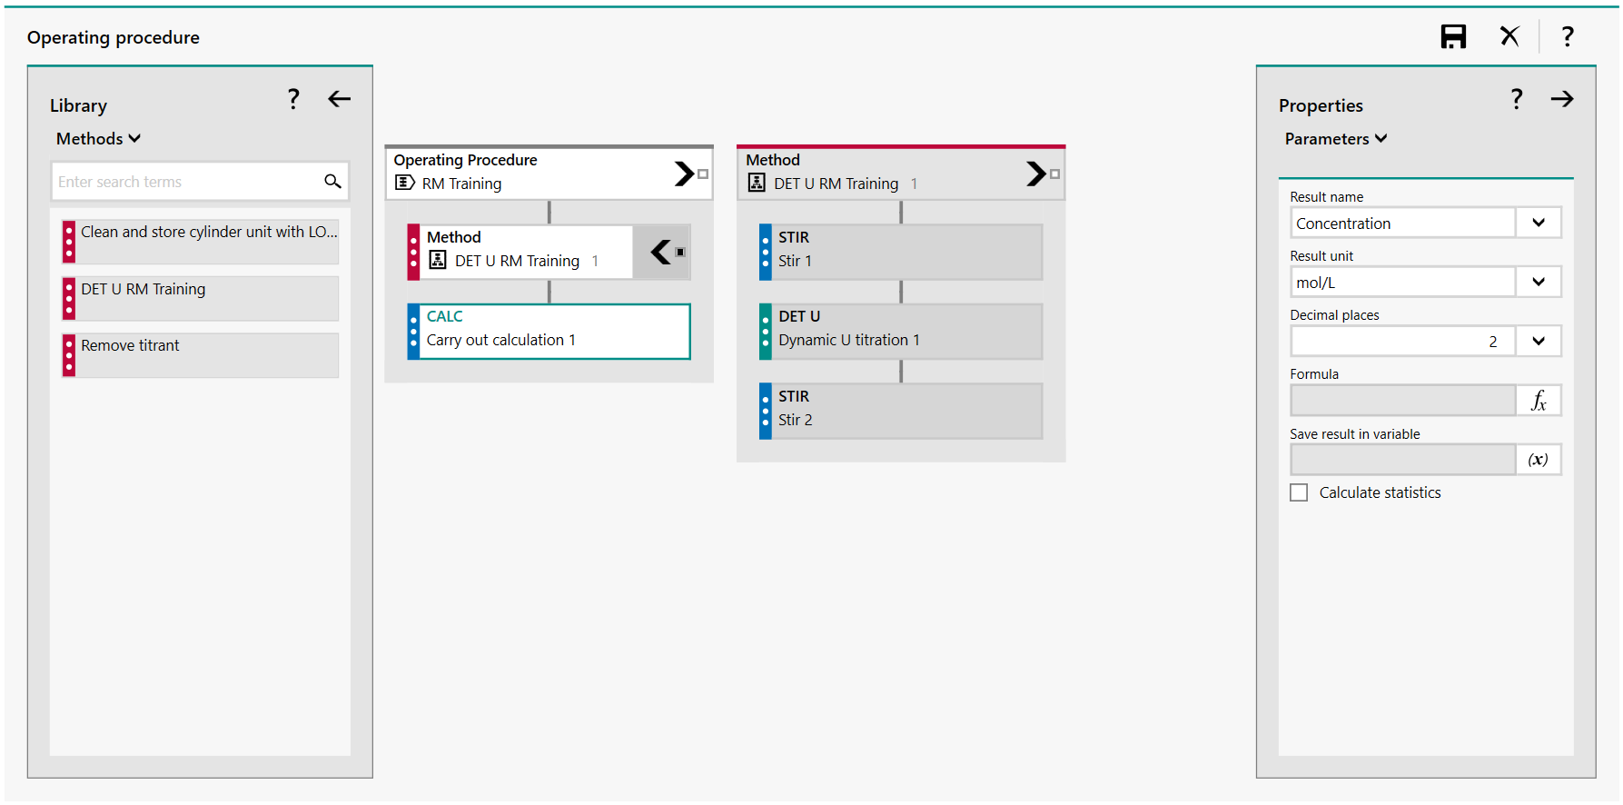
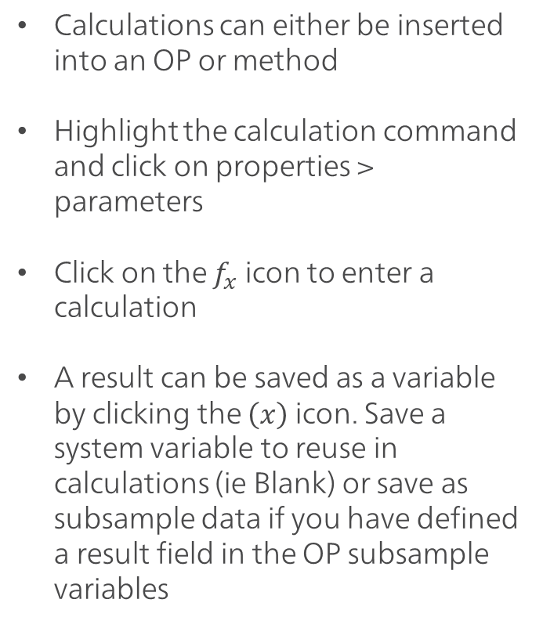
Calculations
Calculations can either be inserted into an OP or method
Highlight the calculation command and click on properties > parameters
Click on the $f_{x}$ icon to enter a calculation
A result can be saved as a variable by clicking the $\left(x\right)$ icon. Save a system variable to reuse in calculations (ie Blank) or save as subsample data if you have defined a result field in the OP subsample variables

Slide 23
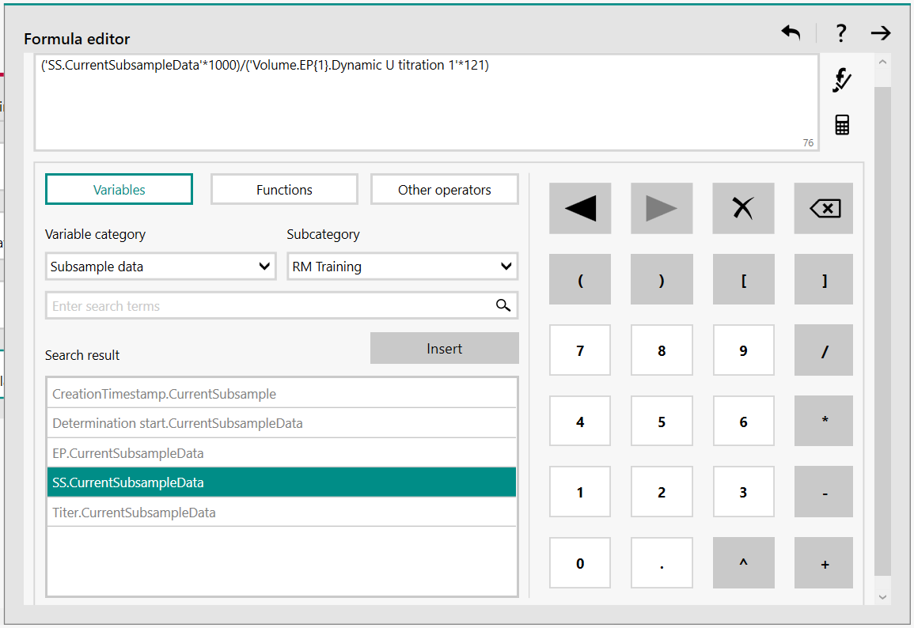
Calculations: Formula Editor
The formula editor is used to enter calculations for results
The sample size can be found in the subsample data (choose correct subcategory)
The endpoint (EP) is part of the titration command, so it can be found as a command variable. Therefore, to find the EP, the calculation needs to be in the method, not the OP
To use the titer value on the bottle cap RFID tag, it can be found as an equipment variable since the solution is listed in the equipment. Subcatagory will be of the current work system

Slide 24
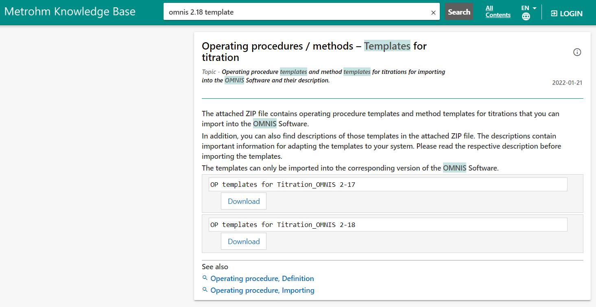
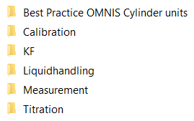

Importing Template Operating Procedures
Template OPs/methods can be downloaded from the Metrohm Knowledge Base
Gives OP files (.opro) for stand-alone and automation systems
REMEMBER - titer determination for Europeans is a factor and that in the USA a titer is the titrant concentration
Basic edits of templates is still required to be able to use them
Import .opro in the operating procedure processes (unzip folder first!)

Slide 25
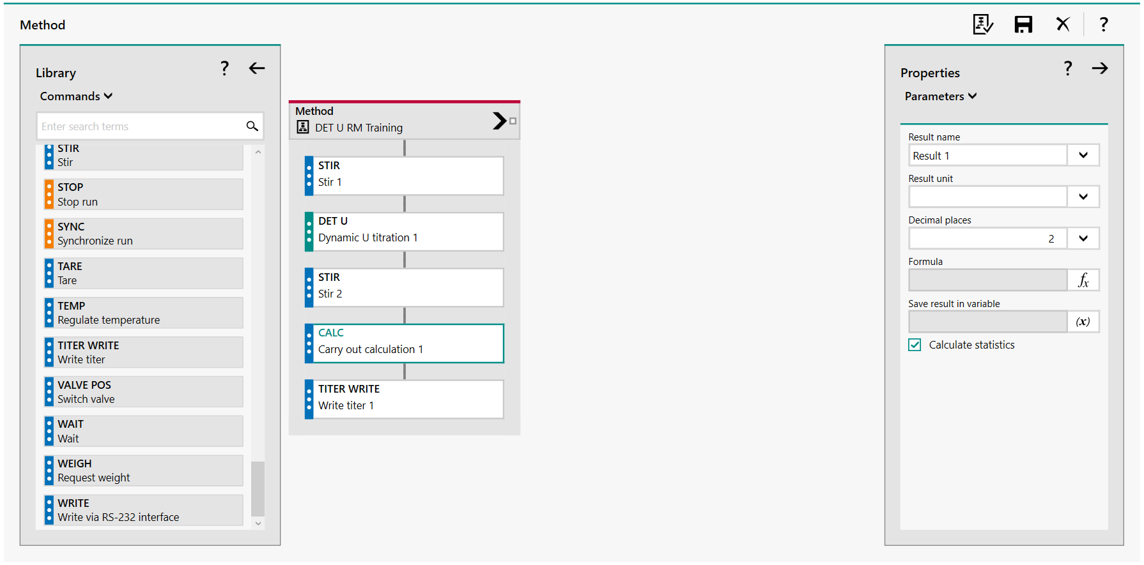
Saving a Titer Value
To save a titer result to the solution, create a method that has a titration command, followed by a calculation command, followed by a titer write command.
This command option is not available in the OP command list
To take the average titer, check the box for calculate statistics
In the titer write command, define the titration command and the calculation command

Slide 26
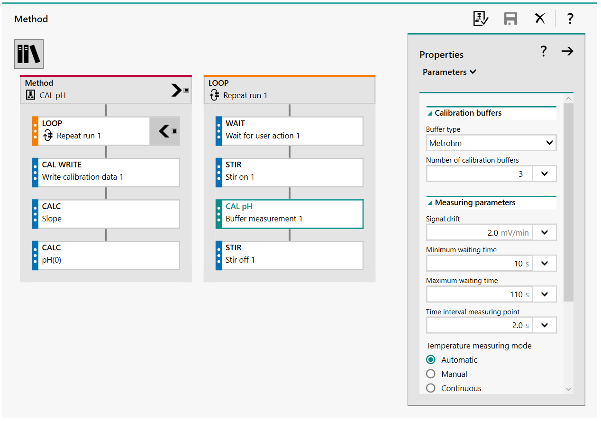
pH Electrode – Calibration
The pH calibration method/OP runs a loop sequenced based on how many pH buffers to be used. The number of loop cycles equals the number of buffers to be used
In the command CAL pH parameters, define what type of buffers to be used and the number of buffers.
The calibration data can be written to the electrode using the CAL WRITE command if the measuring module that the electrode is connected to is defined in the execute with of the CAL pH command
Automatic recognition of pH calibration buffers based on their potential

Slide 27

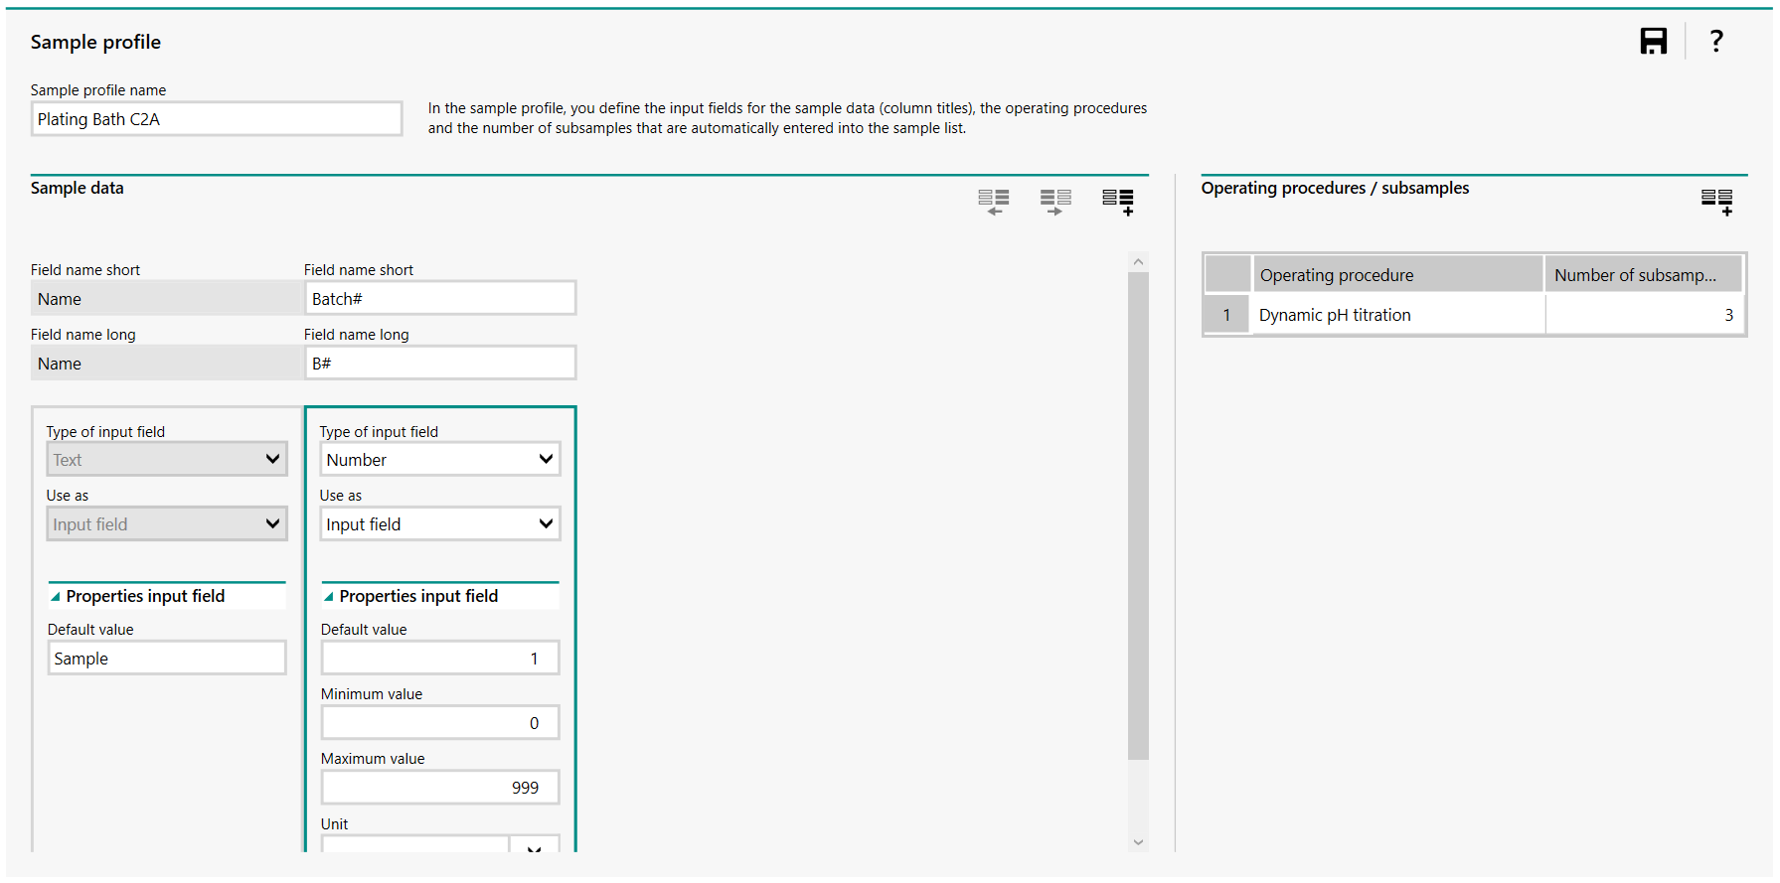
Creating Sample Profiles
The name of the sample profile (ie plating bath C2A, Water Tank 32, etc.). Remember the sample is the focus!
Sample profiles define what input fields are displayed in the sample list for the sample, not the subsample (ie batch number, location, etc.)
Sample profiles can be thought of as a sample table template
The OP(s) that is/are used for the sample and number of subsamples to be run is defined

Slide 28

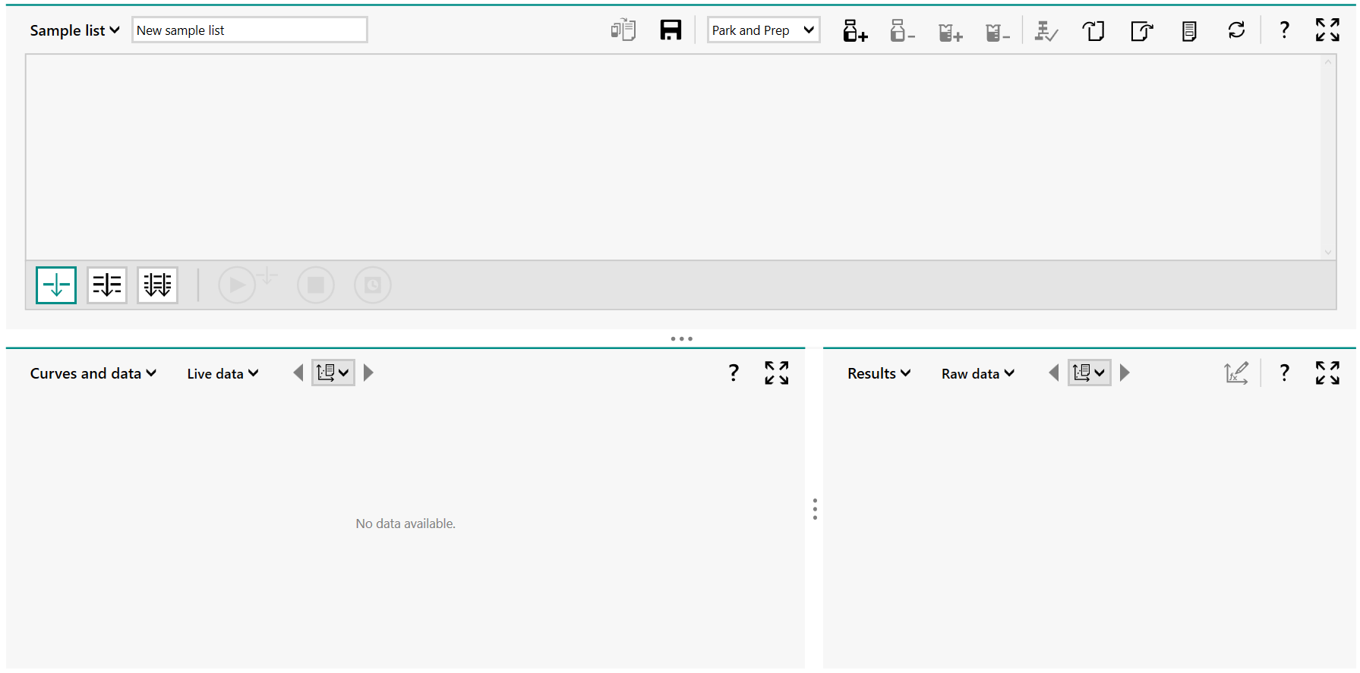



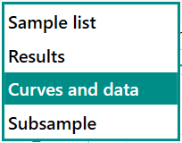
Sample Lists
A sample lists is where a sample table can be made, where samples are run, where we can view live titration curves, look at previously run sample titration curves and results, print reports and reprocess data
Name the sample list and select a sample profile for your sample and click the add sample icon
If a mistake is made, a sample profile can be removed* from the sample list , or we can add and delete subsamples
Views can be rearranged by clicking the drop down next to Sample List, Results, Curves and Data and Subsample
*Even if a sample is removed from the sample list, it will still be present via a search query.

Slide 29

Sample Lists Icons
Choice between series and parallel determination.
    Series determination: Analyze all executable subsamples in the sample list sequentially.
    Parallel determination: Analyze all executable subsamples in the sample list simultaneously.
There is the option to run a single determination, a series determination or parallel determination (multiple work systems)
Determinations can be started, stopped, stopped after a delay or live edit a series determination
OMNIS Software – Overview of functions

Slide 30
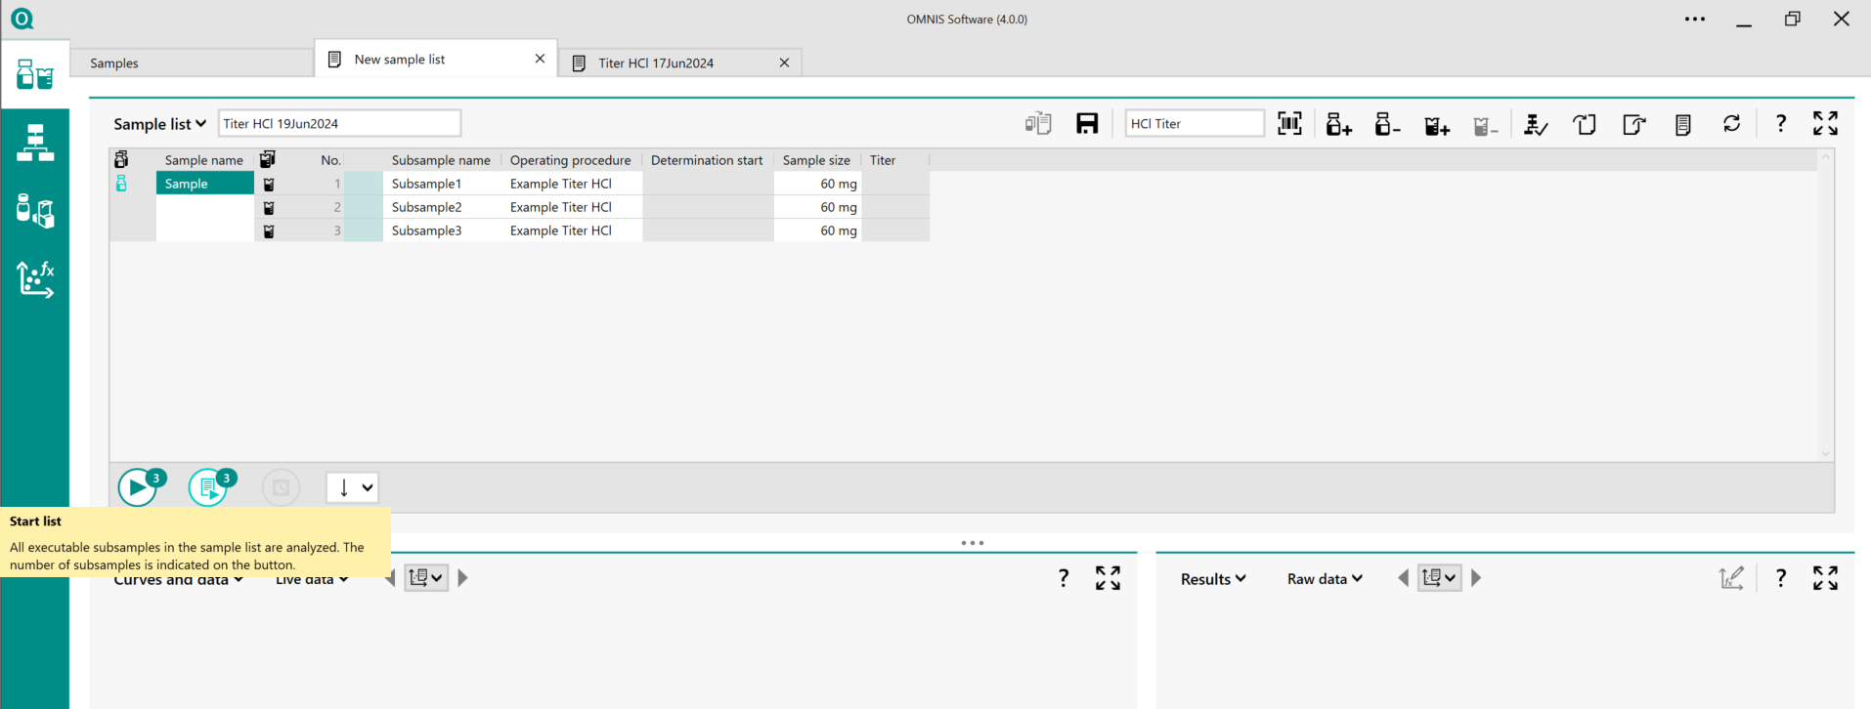
Starting a Sample List
Highlight the determination(s) in the sample list to be run
Choose to run a single determination or series determination
If multiple subsamples are defined in the sample profile, they must be run together
Click the start icon to start running samples

Slide 31
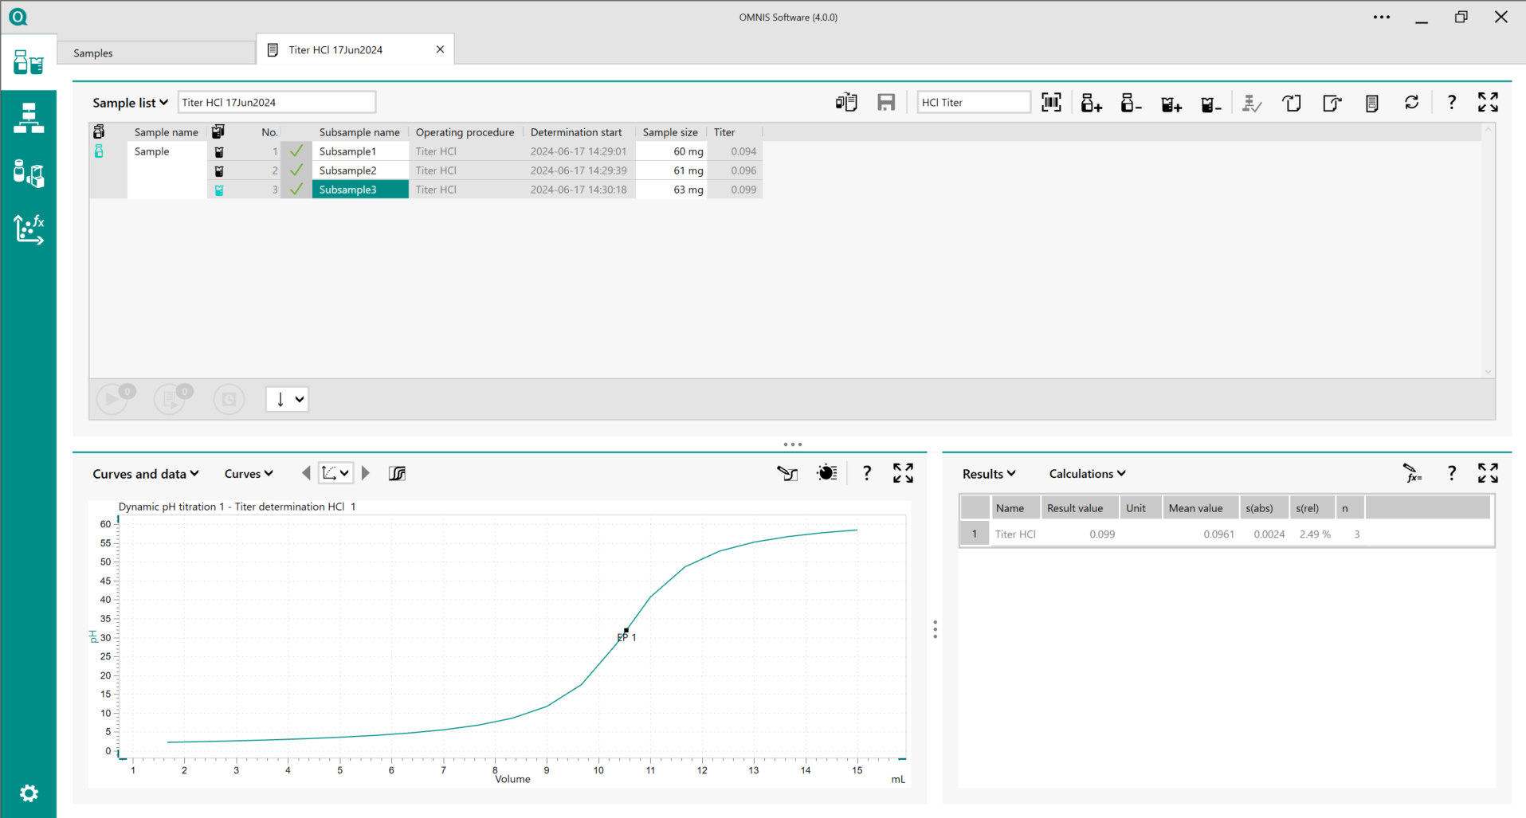
Running a Sample
The live titration curve will be displayed while a sample is running
The scale of the y- & x-axis can be changed by clicking and dragging the green lines on the curve display
An orange work system icon will appear below the equipment. This will show you all work systems that contain functional units that are currently being run

Slide 32
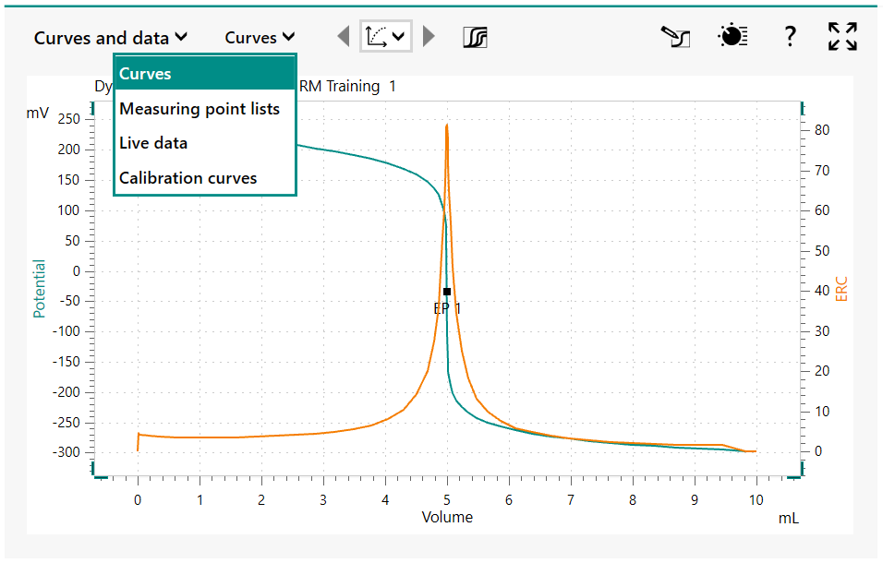



Curves and Data
Clicking the drop down we can switch between the curves of run determinations, seeing a measuring point list, viewing live data and calibration curves
Titration curves can be overlayed by clicking
A second y-axis can be added by clicking the properties icon of the curve displayed
Reevaluate a titration curve (for EPs) by clicking and changing potentiometric parameters (windows, EP criterion, EP recognition)

Slide 33
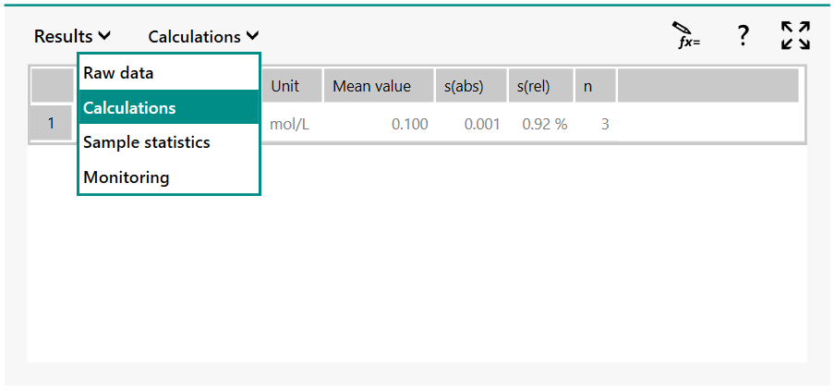

Results
View raw data of a determination (ie EP, time of titration
View results from the calculations defined in the method/operating procedure
If statistics are enabled, view the mean, standard deviation, RSD, etc.
Recalculate results by highlighting the result in the calculations and clicking the icon . The calculation parameters can be edited, such as editing the formula with a correct sample size

Slide 34
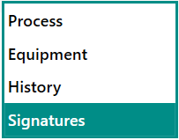
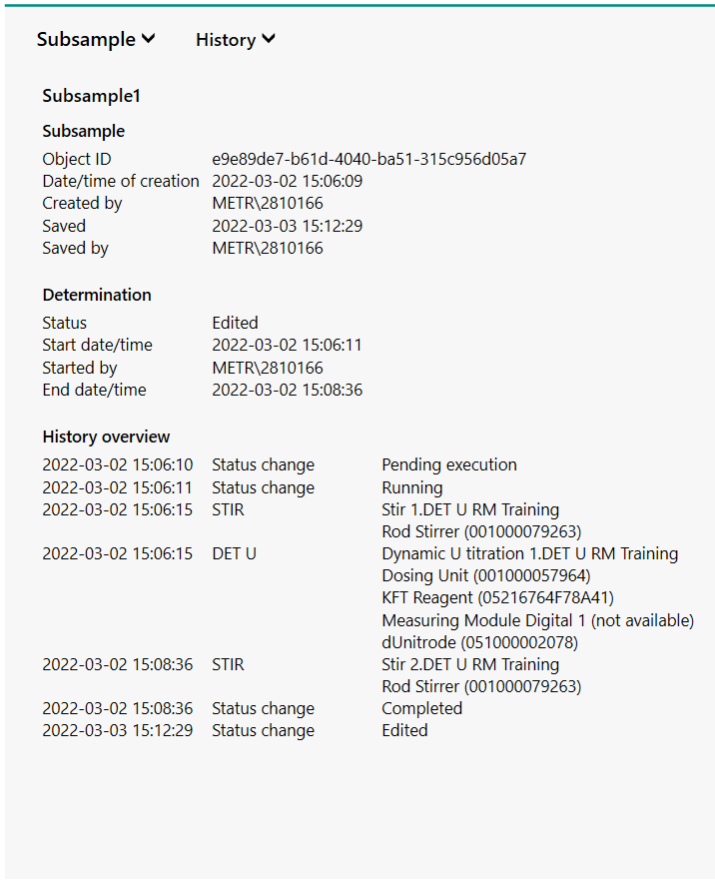

Subsample
The Process, Equipment, History or Signatures can be viewed in the Subsample area if displayed
Process - the method and OP name used for a determination can be viewed. An OP can be restored to the Process work area by clicking
Equipment – can get all information on instruments, work system, sensors and solutions. Including any monitoring, serial numbers, etc.
History – shows the determination history including if it has been edited, when the subsample was run, completed, ect.

Slide 35
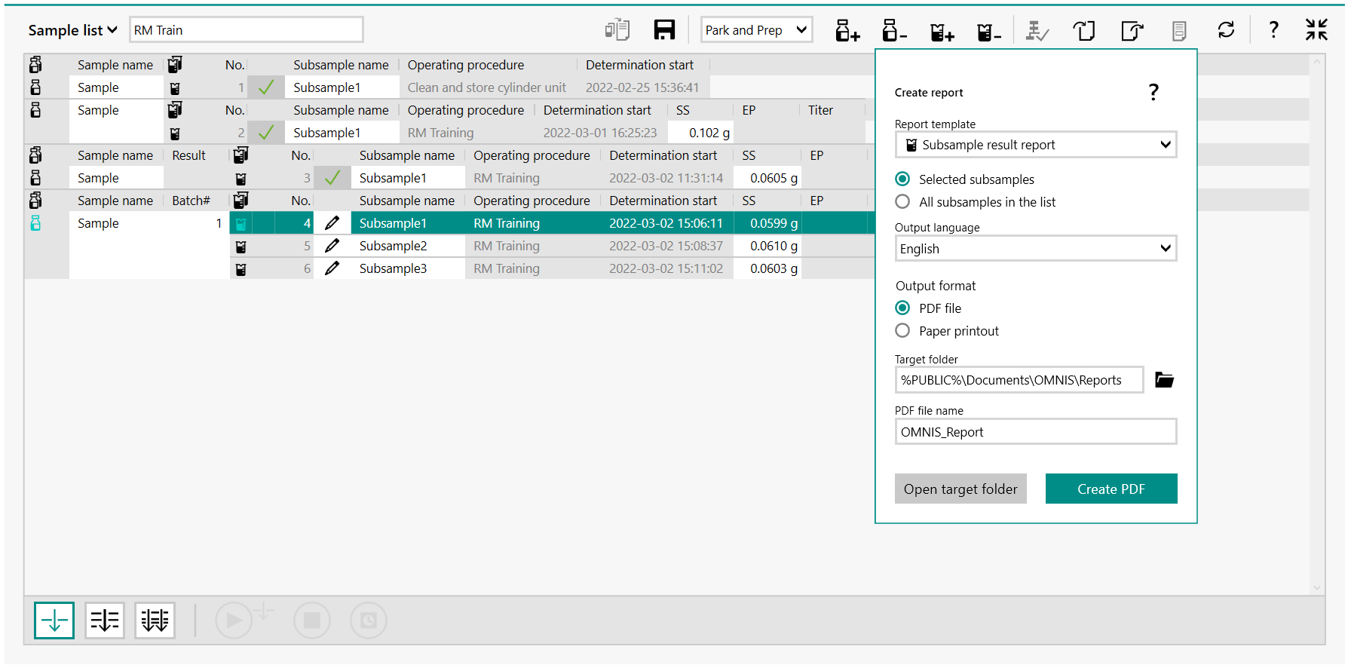
Creating Reports
In the sample list area highlight the subsample(s) to be printed and click on the create report icon
Select which report template you want to use. Report templates cannot currently be edited.
Select printer or PDF and a target location for a PDF
Printer settings are in the General Settings subsection.

Slide 36

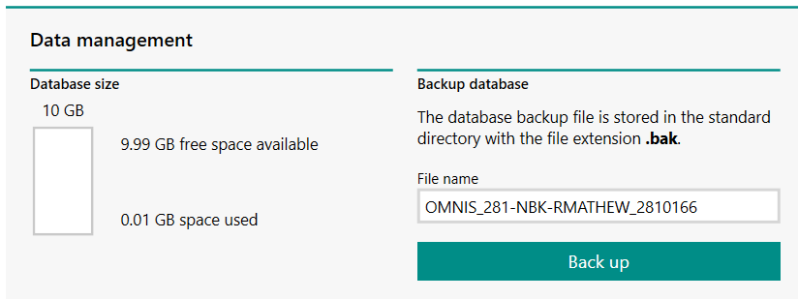
Backup Database
The entire database (ie work systems, sensors, solutions, methods, OPs, sample lists, sample profiles) can be backed up as a .bak file in the Settings work area in the subsection Database Management
Databases can only be backed up in this subsection. Databases cannot be reset or restored here
OMNIS Database Best Practices

Slide 37

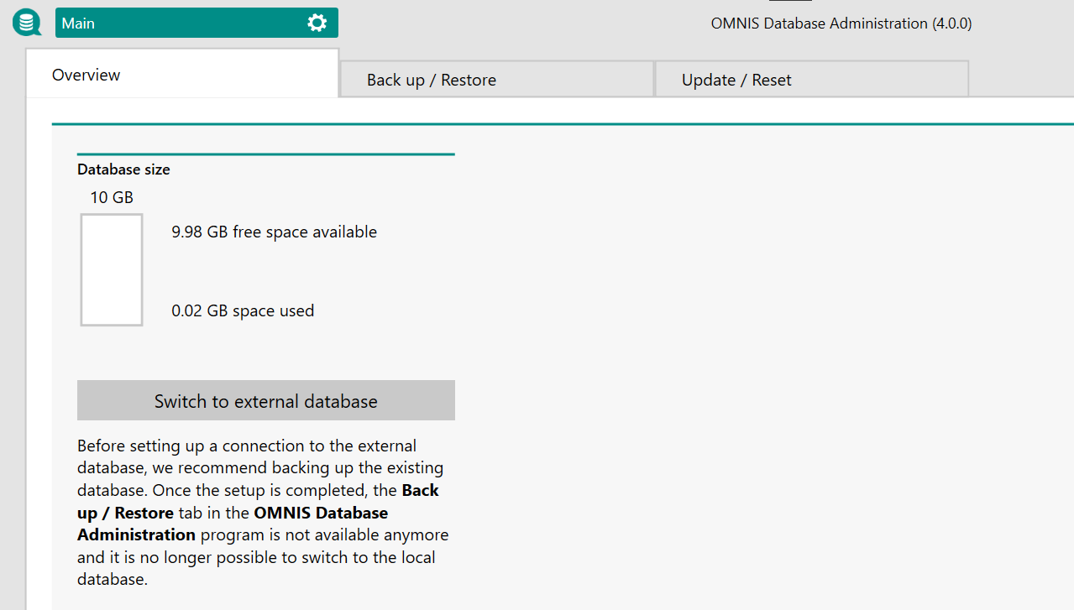
Database Administration
The database administration is a separate application from the software
Databases can be backed up, restored or reset from the database administration
The database administration version must match the version of OMNIS software on the PC. In case the software is updated, the database administration can be updated here

Slide 38
OMNIS Support
Knowledge Base: Metrohm OMNIS Help
  Press F1 anywhere in OMNIS to access the help menu
  Hover over icons to have them identify what they are and look for the to link to the online help for that specific area.
Metrohm USA Technical Support: https://support.metrohmusa.com/hc/en-us
  To connect with us, please click “Submit a ticket” at the top right of the page
  This support page includes relevant help notes and guides to keep you running or expand your working knowledge!
Applications Support: https://www.metrohm.com/en_us/applications.html

